Slide 1
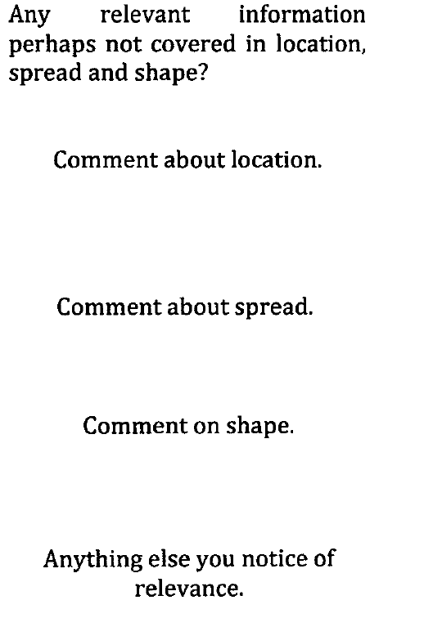
Introduction
Open with a short description of the data.
Body
This is the section where you show how you interpret the distributions.
Conclusion (sort of)
State anything which you think is relevant.

Slide 2
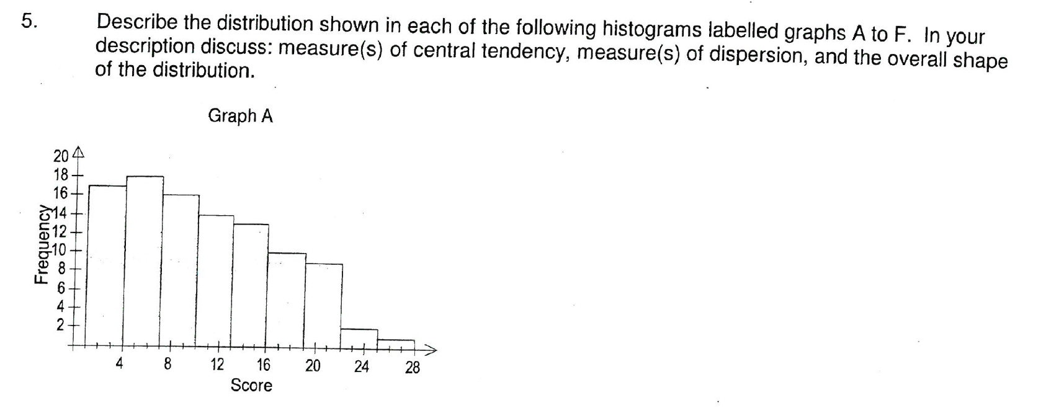
The distribution has 100 scores with an estimated mean of 10.6 (using the midpoints of the class intervals).
The median lies in the interval of 7 to 10 and the modal class is in the interval of 4 to 7.
The spread of the score is from 1 to 28 with a range of 27.
Using the midpoint of the class interval, the standard deviation is estimated to be 6.17.
The distribution is unimodal and is skewed to the right (positively skewed).

Slide 3
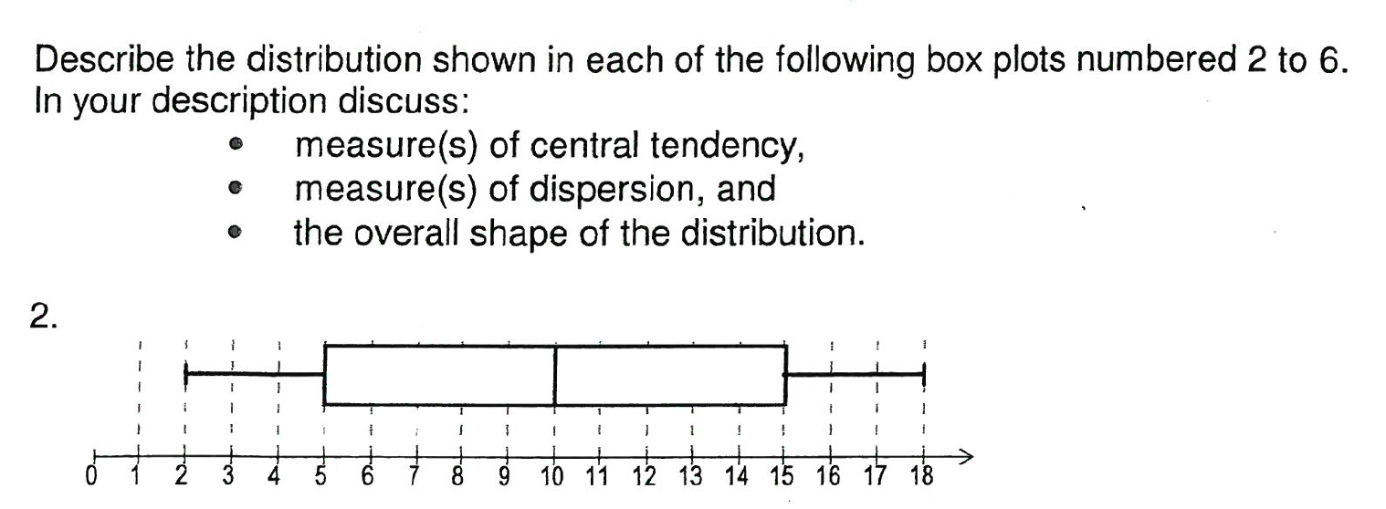
The median of the distribution is 10.
The distribution is symmetrical and the mean of the distribution will be very very close to the median.
The range of the distribution is 16 and the interquartile range is 10.
There is no outliers in this set of data.

Slide 4
